Slide 1
Downloading Git
SISMID Lab Supplemental Material
July 22 through July 24, 2026
A Human – AI Teaming Approach to Infectious Disease Modeling

Slide 2
Roadmap
This slide deck provides a step-by-step walkthrough of downloading Git onto your local system.
If you run into issues, please first work with the AI of your choice to troubleshoot.
If you continue to have issues, please reach out to Amanda Bleichrodt (ambleic@clemson.edu).

Slide 3
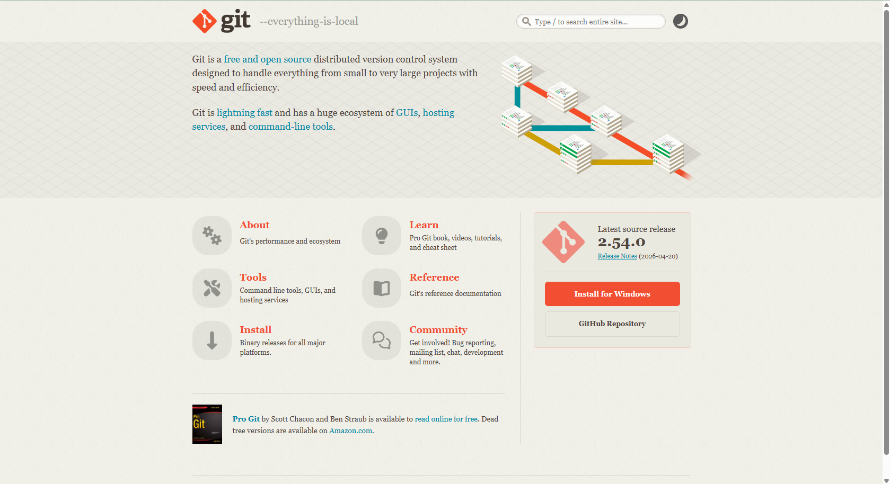
Git is software you install on your computer. It tracks changes to files — like a save history for your entire folder. Every time you "commit," Git takes a snapshot of your files. It runs silently in the background. You will never interact with it directly.
https://git-scm.com/

Slide 4
Step 1: Installation
Once you have navigated to the webpage, you should see an installation option on the right side of the screen. Click the “Install for {your operating system}” button.

Slide 5
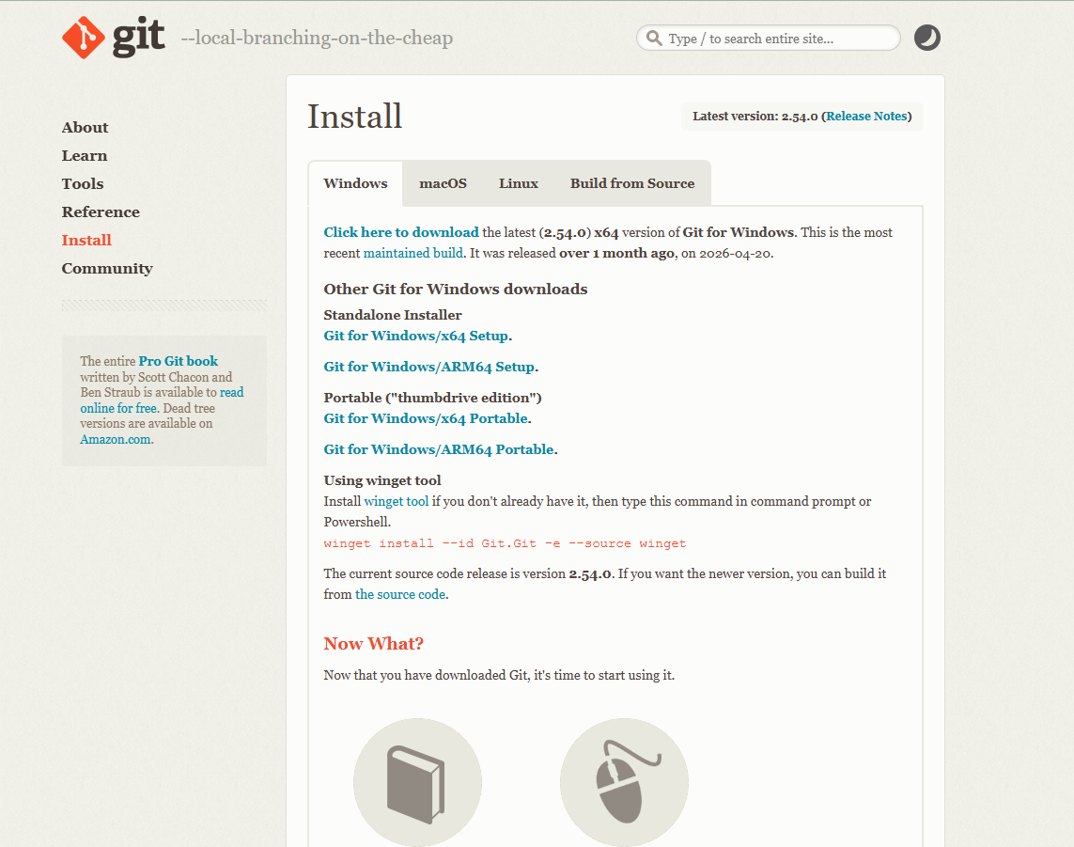
Step 2: Selecting the Correct Operating System
After clicking the “Install” button on the previous page, you should see a page similar to this appear. At the top of the page, there are tabs for different operating systems. Double check that you are on the correct tab for your system.

Slide 6
Step 3: Downloading Git
After double checking you are on the correct tab, click the ‘Click here to download’ at the top of the page. This will download the Git installer to your system.

Slide 7
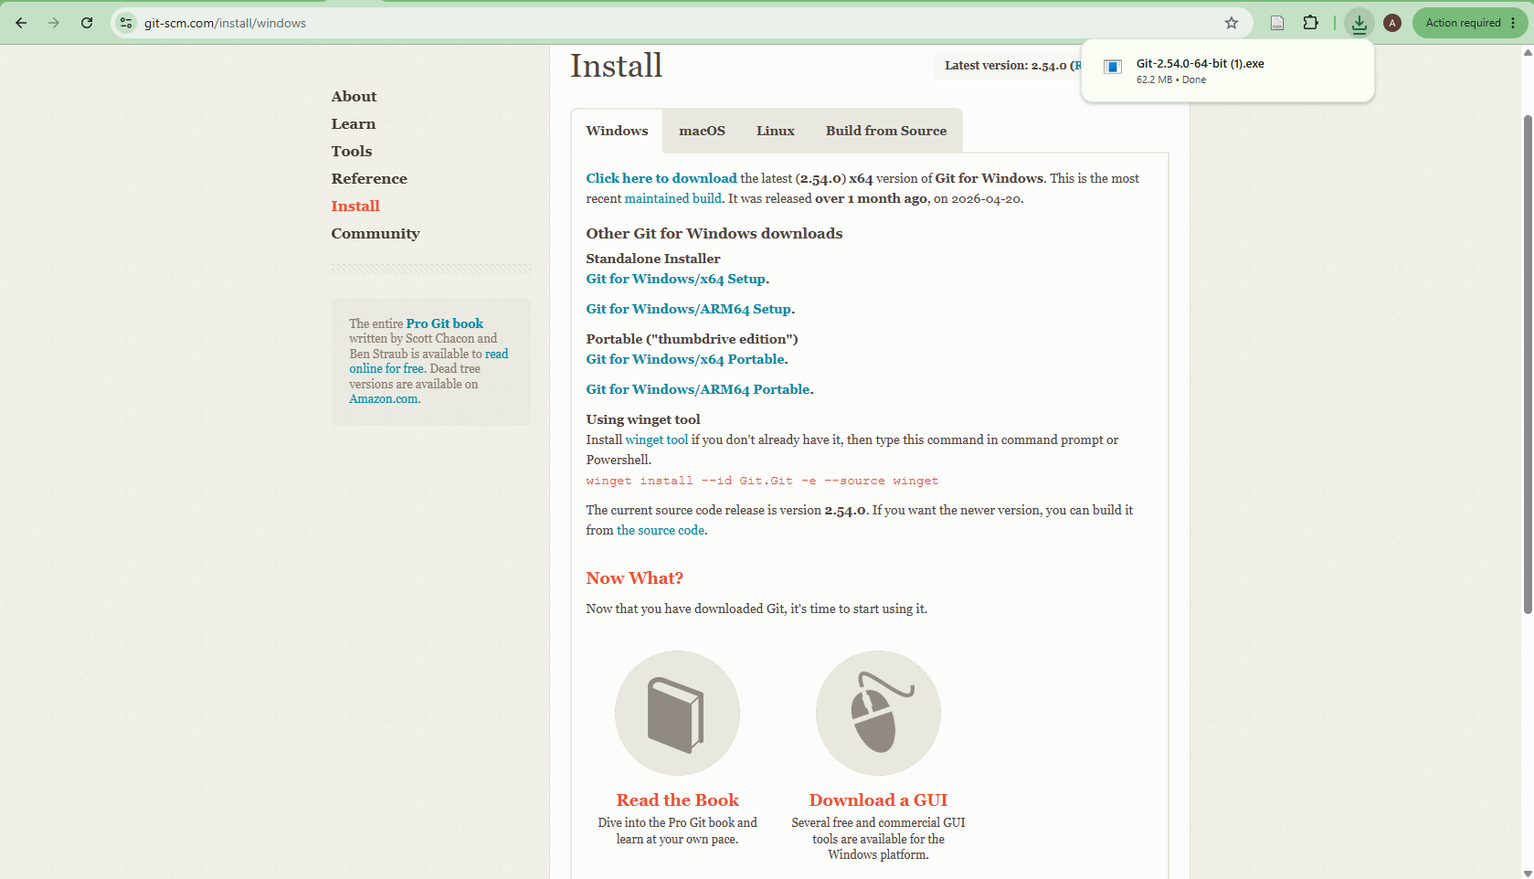
Step 4: Starting the Installation
You should now be able to see the Git installation in your system’s download folder. Double click to open it.

Slide 8
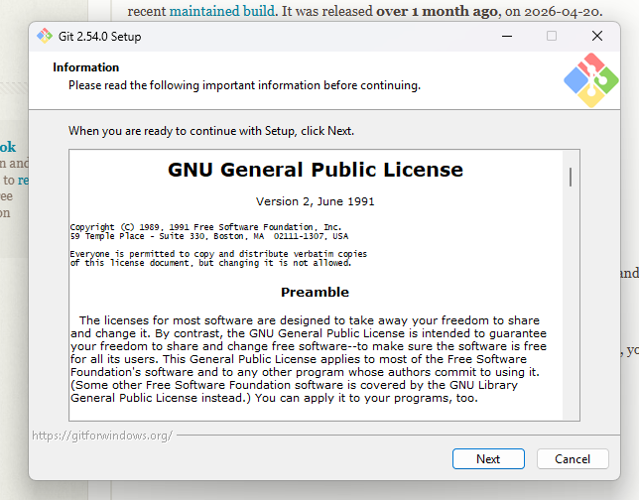
Step 5: Git Set Up
After clicking on the Git download, you should see a pop-up appear. We will use the default settings of Git, so click next until through all of the menus.

Slide 9
If you run into any issues downloading Git, please let us know. While Git is helpful for the lab and for pushing code directly from VS Code to GitHub, we will also demonstrate alternative methods for submitting and sharing your work.

